Slide 1

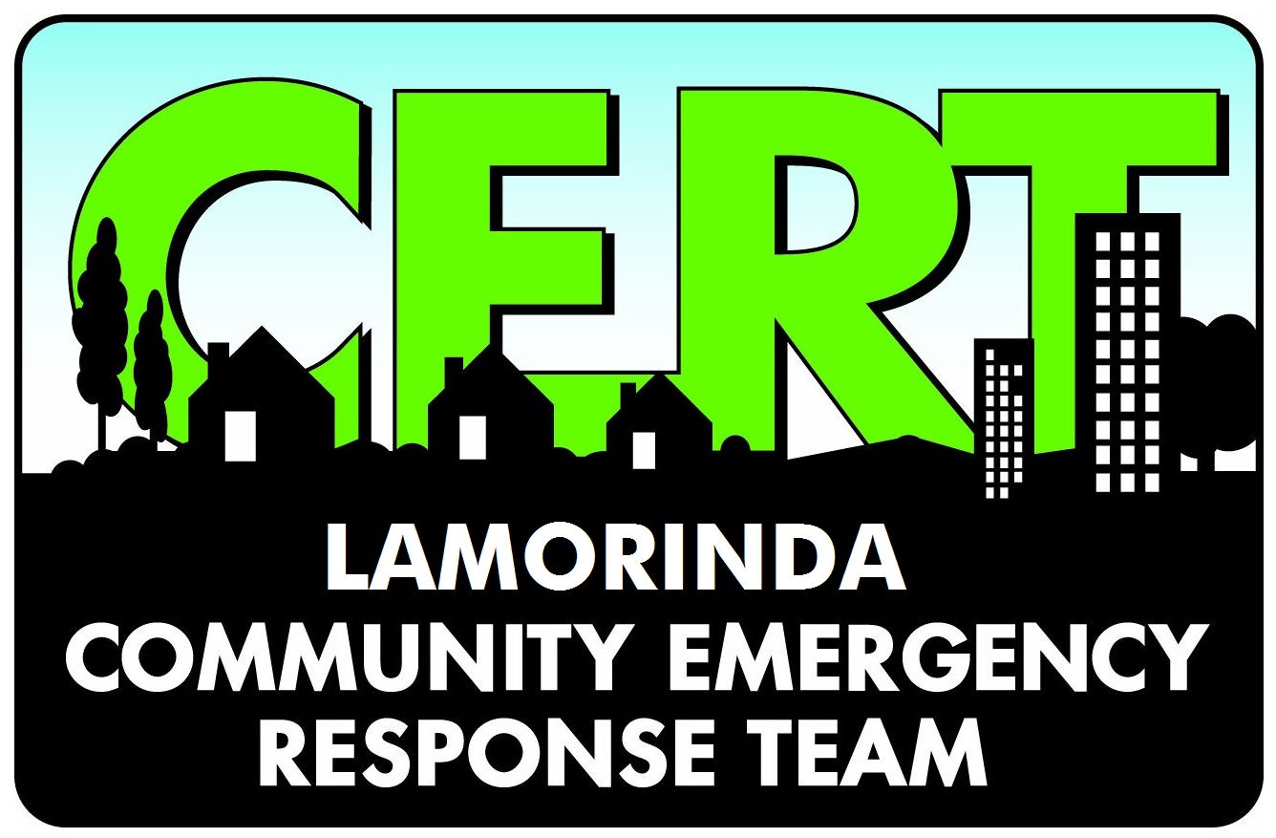
Community Emergency Response Team
Rapid Needs Assessment
Released: 17 January 2024
Lamorinda CERT

Slide 2
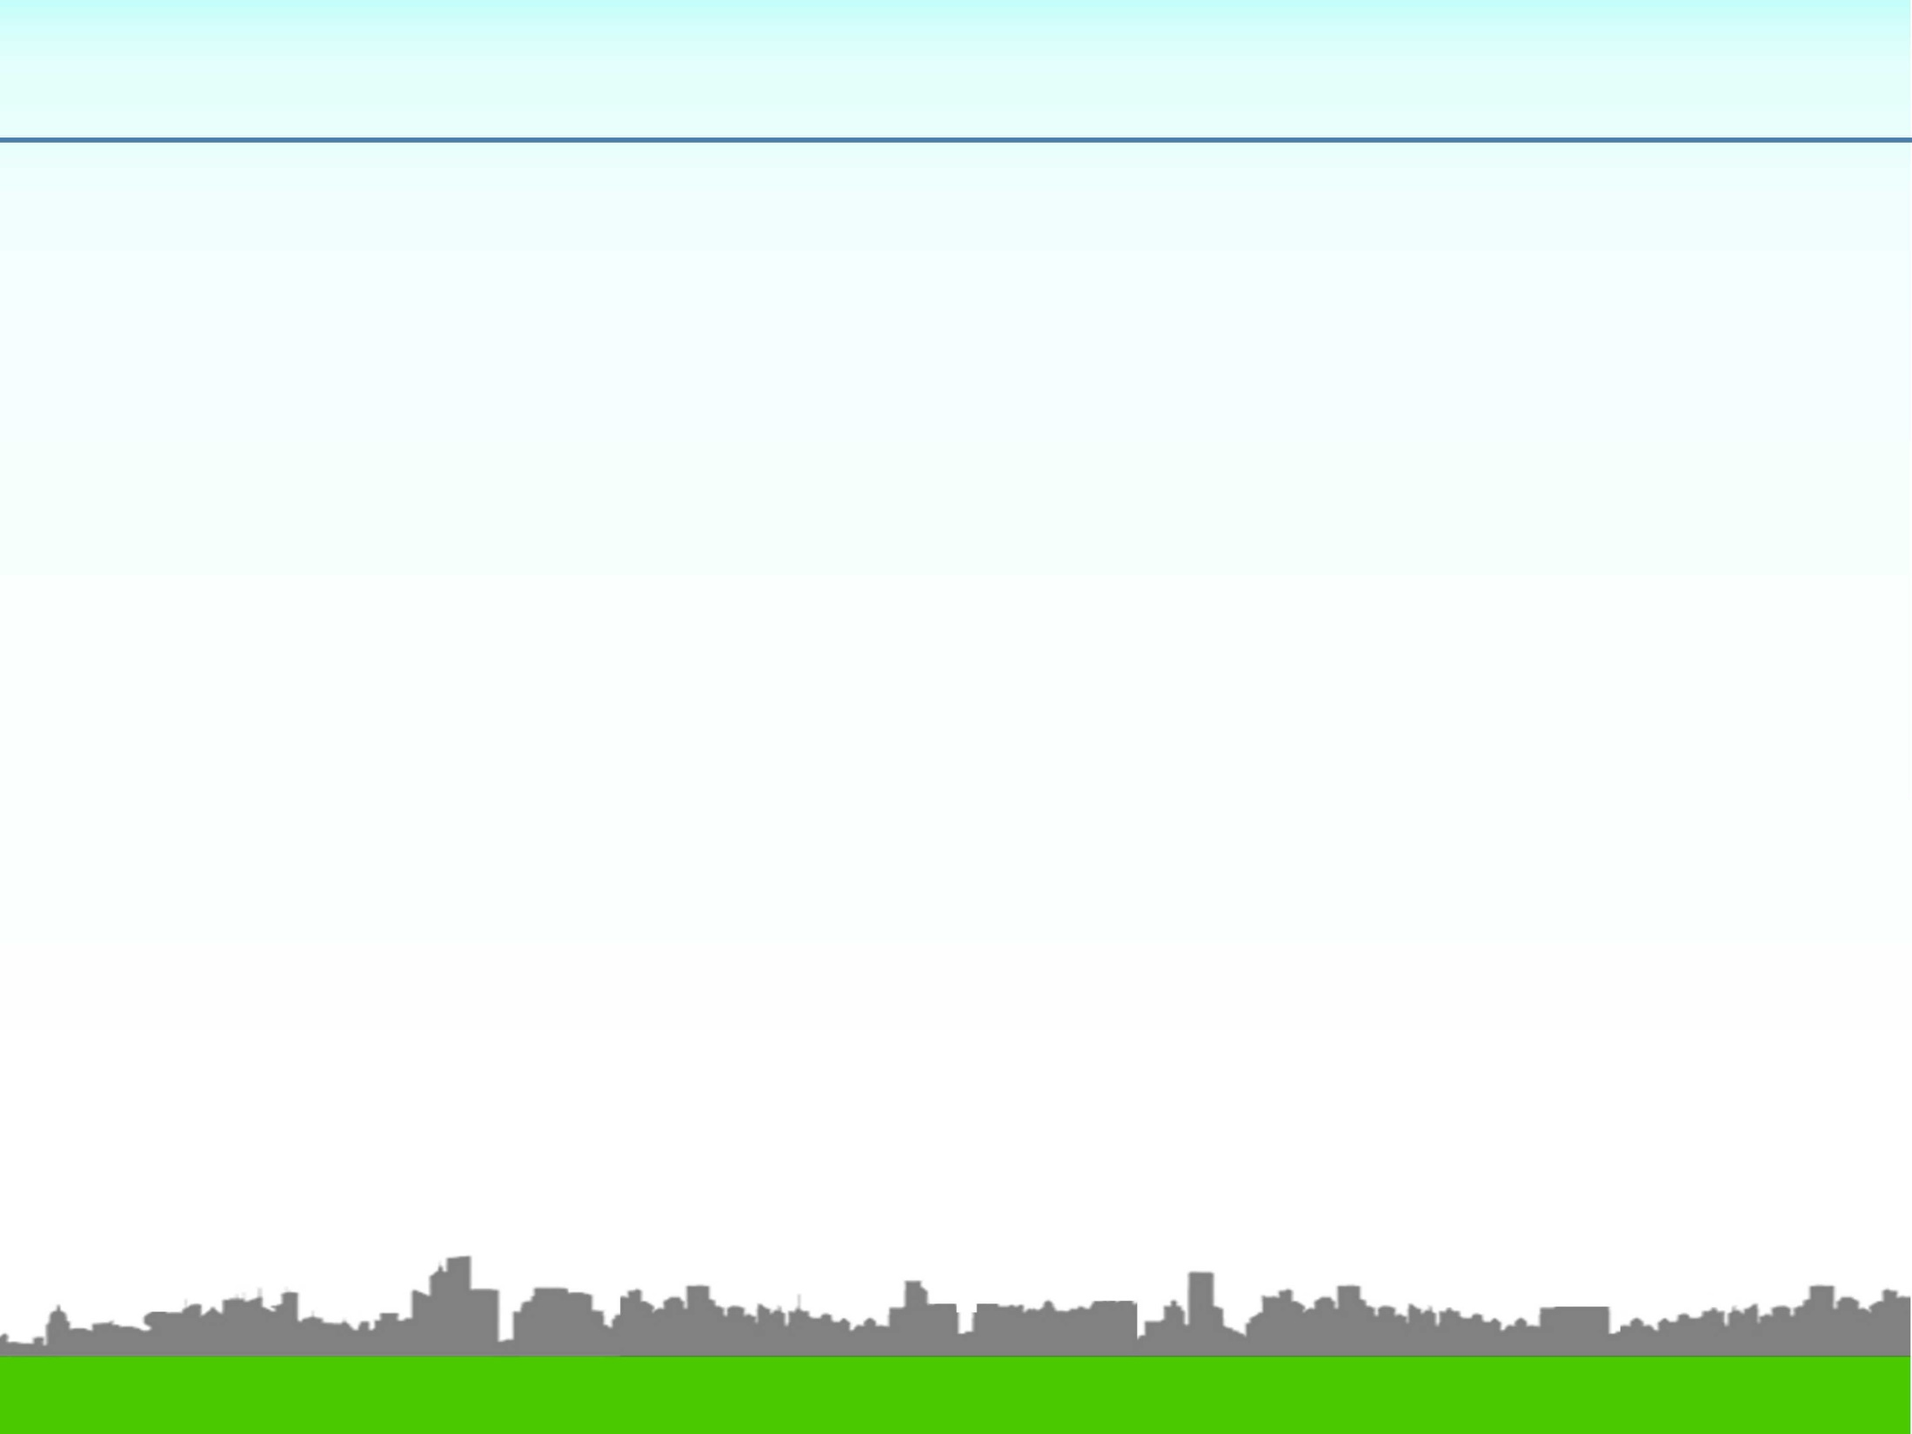
Rapid Needs Assessment Form
The ability of local governments to
perform a Rapid Needs Assessment
accurately and within the first few
hours after an incident or emergency
is critical to providing a response
designed to save lives and support life
sustaining actions.
FEMA G557
Visual RNA.1
Lamorinda CERT

Slide 3
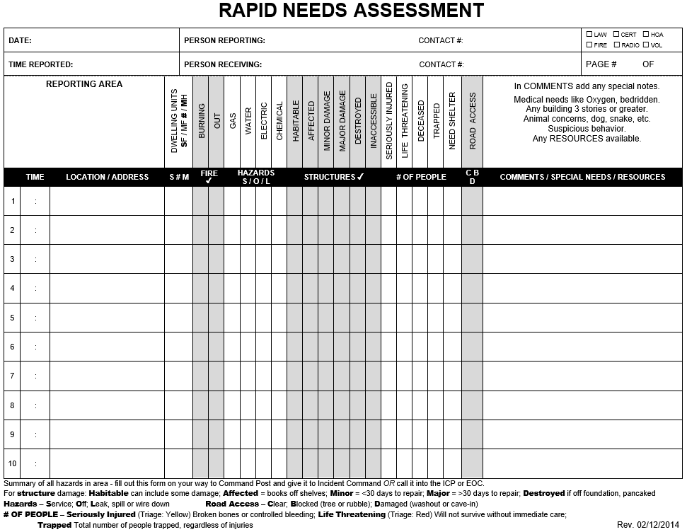
Rapid Needs Assessment Form
Visual RNA.2
Lamorinda CERT

Slide 4

Rapid Needs Assessment
Record everything on the RNA form
Call in by radio only life-threatening emergencies
Whe reporting:
State nature of emergency: Victim bleeding, trapped in bedroom, etc.
State location: 623 Country Club Dr., Moraga
State safety issues: Building has Major damage
Visual RNA.3
Lamorinda CERT

Slide 5
Rapid Needs Assessment
If no address, state longitude and latitude fro your cell phone compass app:
SAY: Location is: Lat-Long 37 decimal 866342 minus 122 decimal 105747 OR
SAY: Location is: Lat-Long 37 degrees 51 minutes 59 seconds North 122 degrees 6 minutes 21 seconds West OR
SAY: Victim is: 30 yards northwest of Lat-Long 3…
Visual RNA.4
Lamorinda CERT

Slide 6

Questions ?
Visual RNA.5
Lamorinda CERT

